Slide 1
Formal Modelling Of The Reactor Protection System Of Nuclear Power Plant
1. Hima Sagar Janagama (191it120)
2. Shwetha Jaya Prakash M (181it245)
3. Sai Krishna Konda (191it224)
4. Manikesh

Slide 2
Problem Statement
Formal Modelling Of RPS Of Nuclear Power Plant
Using UPPAAL

Slide 3
Introduction
A nuclear Power plant is a thermal power station in which heat is Produced by a nuclear reactor.
it will be dangerous to ecosystem if we don't maintain it properly.
It has many safety systems and one of them is reactor protection system aka RPS

Slide 4
What is RPS
A reactor protection system is a set of nuclear safety and security components in a nuclear Power plant designed to safely shutdown the reactor and prevent the release of radioactive materials.
It generates protection signals for equipment in according to the variation of operational parameters to prevents the reactor from exceeding the specified safety limit, or mitigate the damage by driving the reactor emergency trip (RT) and engineering safety features (ESF)

Slide 5
The RPS control mechanism has the following characteristics:
multiple action types: normal, rt and esf
multiple protections
multiple trigger conditions
multiple inputs
Threshold judgment

Slide 6
Parameters used
we have used two parameters for our model. namely,
Pressurizer pressure
Neutron flux

Slide 7
Test case design
System analysis is performed to classify the control function of the target system.
The core logic functions is used as threshold comparison of the control system and the threshold boundary is analyzed.
According to threshold boundaries, we design and generate a set of test case.

Slide 8
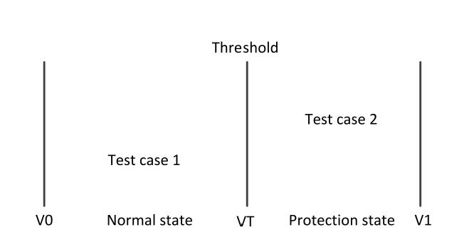
Contd.

Slide 9
Methodology
Take a value from the normal state range as input of first test case.
Take a value from the protected state range as input of 2nd test case.
Perform 2 test cases sequentially as a set of test cases for protection func test as one test.
Restore and reset the parameters after completion of previous test

Slide 10
UPPAAL
we used uppaal for modelling the system.
two independent parameters, so we made test cases combining both parameters for better and more accurate results
after modelling, we verified the states of the system and each and every time the results were accurate and that proves that our proposed model is doing good

Slide 11
how did we modeled it
two independent parameters
each one has two states and it can either cross threshold or not.
so, we have 3 cases under the first state
case 1:
Both parameters cross threshold
case 2:
parameter 1 crosses threshold but parameter 2 doesnt
case 3:
parameter 2 crosses threshold
but parameter 1 doesnt
under this each case has another 3 cases i.e both parameters can change or any one from them can chane

Slide 12
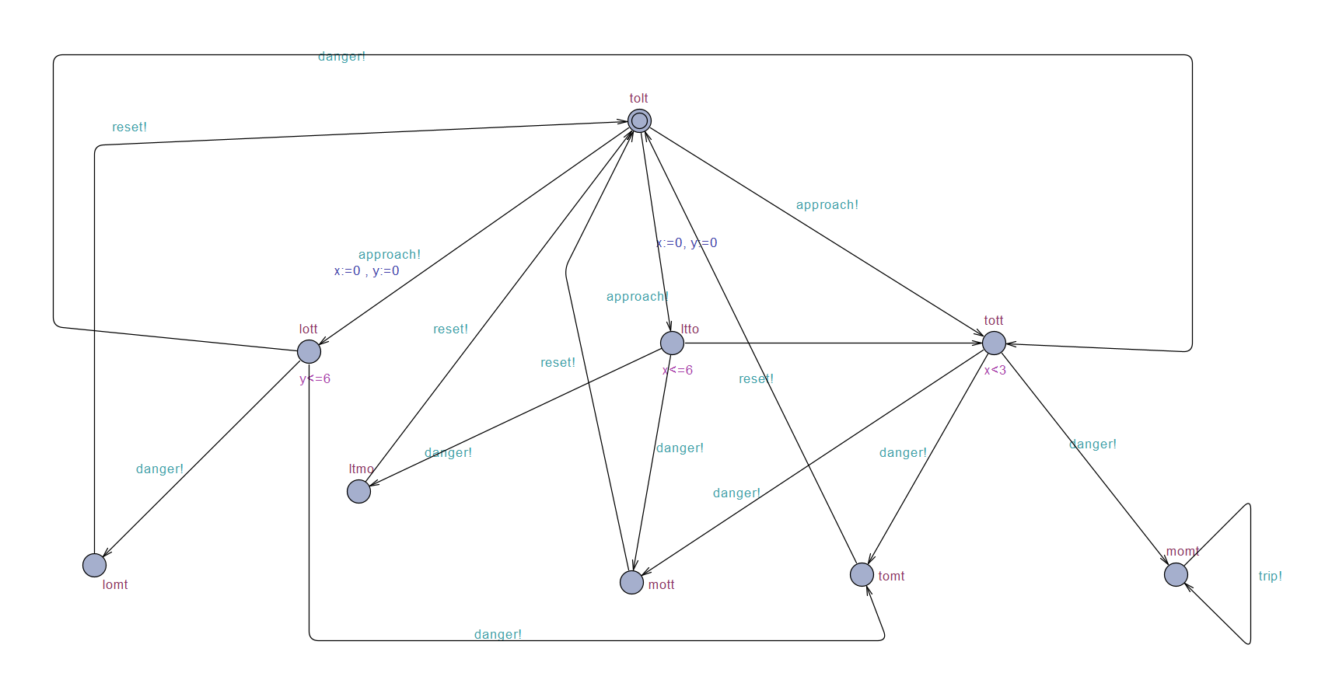
figure 1

Slide 13
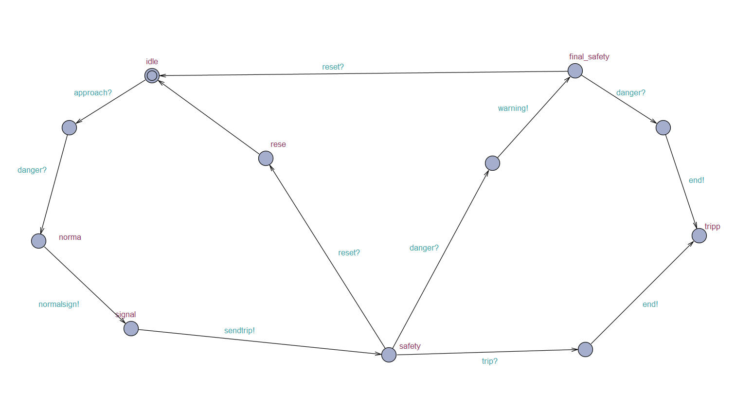
Figure 2
this is the modeled diagram of layer 2
it receives signals from layer 1
it calculates and analyses the issue and send signals to layer 3

Slide 14
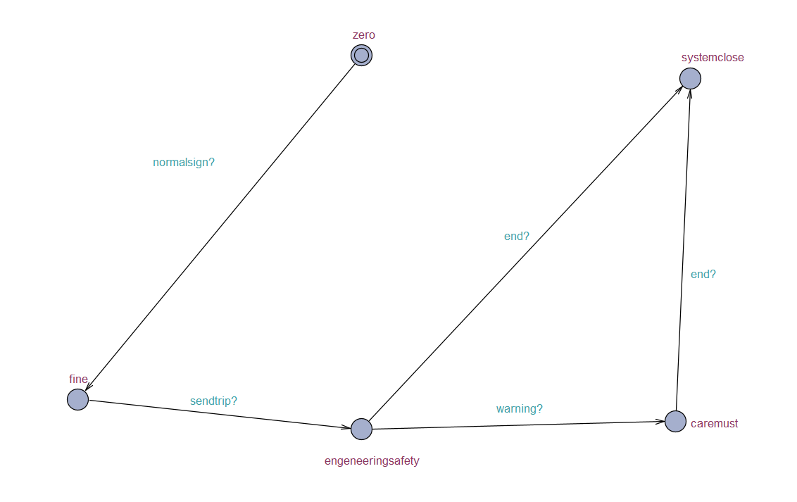
Figure 3
this is the final layer and its the result of all the calculation and it gives the state of nuclear power plant and instructs workers about the state

